Slide 1

Internship Seminar
11S4190
Pembangunan Sistem Informasi Penerimaan Mahasiswa Baru Universitas HKBP Nommensen Medan berbasis Web
Development of Web-based New Student Admission Information System of University of HKBP Nommensen Medan
Pusat Sistem Informasi Universitas HKBP Nommensen Medan
KP-24-623-A
MISSYOLIN EUNIKE RUNGGUNI SAMOSIR
11S21008

Slide 2
Overview
Institution Description and Background
Activity Implementation
Information System Development
Result
Suggestions and Recommendations

Slide 3
Institution Description and Background
The University of HKBP Nommensen (UHKBPN) in Medan is managed by the UHKBPN Foundation and provides information systems for academics and admissions.
The Information Systems Center (PSI) is responsible for computing services, teaching, research, as well as the development of the New Student Admission (PMB) application.
The PMB management system that was created in 2016 with native programming requires improvement in functions and user interface.

Slide 4
Activity Implementation
Objective
Develop a new system that is in accordance with the development of needs and ease of use.
Internship Implementation Period
10 Weeks (from June 3, 2024 - August 9, 2024)
Online
Coordination and Reporting
Information system development tasks with objectives that have been written in the ToR document.
Every development of the system built will be reviewed by the supervisor through online meetings and Whatsapp.
Scope of Work
Requirement Gathering
Analysis
Design
Implementation

Slide 5
The current system needs to be improved to match the development of UI and increase functionality.
There is a development of a new student admission information system that has improved and added new features, as well as developing UI design.
Requesting current system technical documents
Tech stack specifications using PHP programming language, Laravel framework (PHP-based) and MySQL DBMS
Information System Development
Requirement Gathering

Slide 6
Detailing of the results of requirement gathering
Analysis of technical documents and current system
Flow of target system
Selecting tools to design BPMN, UI and database, text editor, database management tool, email testing, and project repository.
Information System Development
Analysis

Slide 7
Information System Development
BPMN Design
Database Design
User Interface Design
Design

Slide 8
Develop Admin panel dan User panel
Manage frontend and backend
Frontend: Blade Templating Engine, PHP, HTML, Javascript, Bootstrap.
Backend: PHP, Laravel Framework, SQLyog, Mailtrap, Package (Indoregion, Maatwebsite)
Information System Development
Implementation

Slide 9
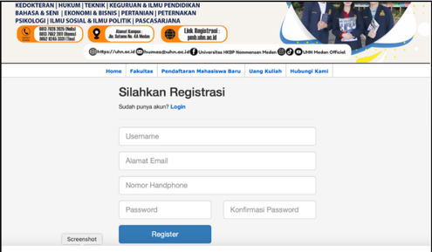
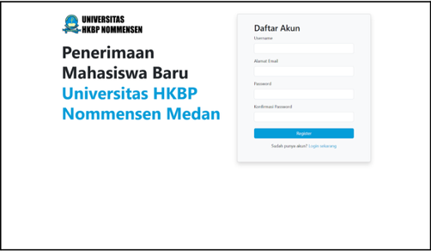
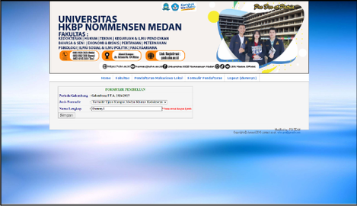
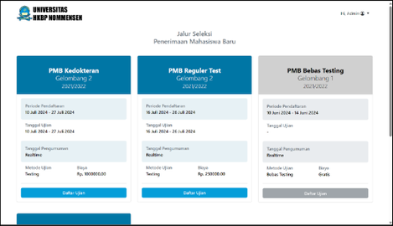
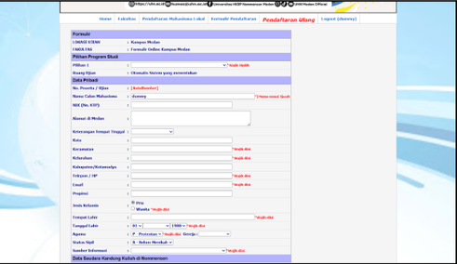
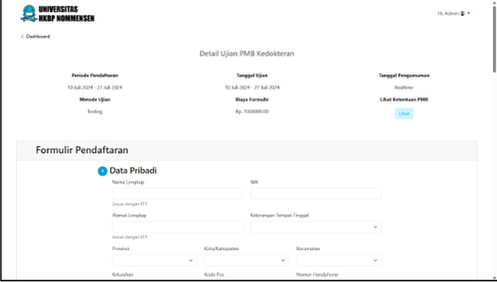
UI comparison of the registration page
Result
User Interface Design developed
UI comparison of Dashboard
UI comparison of Form page

Slide 10
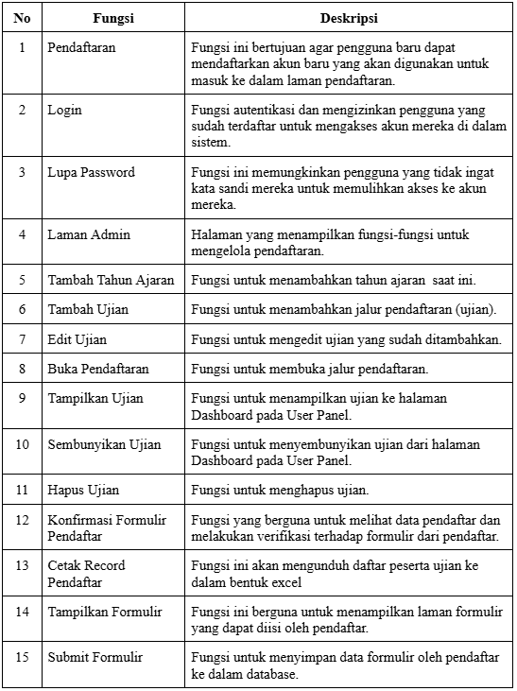
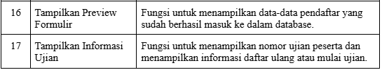
Result
17
Functions in the PMB Information System of University of HKBP Nommensen Medan

Slide 11
Application
Demo

Slide 12
Suggestions and Recommendations
The Internship carried out from June 3 to August 9, 2024 has been completed in accordance with the initial requirements, providing good provisions for students to face the world of work, including the development of technical and soft skills.
Student is able to apply the knowledge gained during lectures well, so that their work is accepted by the company, and gain valuable experience in coordinating and communicating with supervisors.
The Information Systems Center (PSI University of HKBP Nommensen Medan is suggested as one of the internship sites for Del Institute of Technology students in the following year, considering the implementation of practical work that goes well.

Slide 13
Thank You

